Slide 1
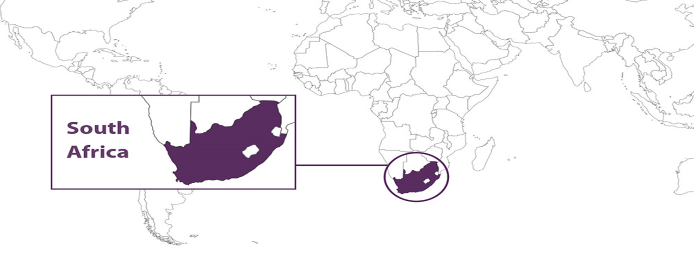
Factors that are most influential on the prevalence of malnutrition in South African children under the age of 5 years
Project Close-out
Presenters: Mncedisi Mncwabe and Lindile Sigweba
11 May 2021

Slide 2

Agenda
Scope
Background
Concept Statement
Objectives
Achievements
Methodology
Project Plan
Project Plan
Analysis Results/Findings
Check in
Data Pre-processing
Block 3
Conclusion
Future Research
Deliverables

Slide 3


Concept Statement
Investigating the factors that are most influential on the prevalence of malnutrition in South Africa in children under the age of 5 years

Slide 4
Problem background and description
The eResearch team is currently working on inquiries and data in consultation with the Department of Science and Technology – National Research Foundation Centre of Excellence in Food Security conducting research on causes and consequences of food insecurity in South African children under the age of 5 years.
Centre of Excellence in Food Security (CoE-FS) is an organization that was launched to undertake innovative research to enable South Africa to tackle the challenge of food security and nutrition.

Slide 5
Problem background and description
Malnutrition refers to deficiencies, excesses or imbalances in a person's intake of energy and/or nutrients.
What constitutes malnutrition?
Prevalence is the proportion of the population that has a certain condition at a particular time
Intrauterine growth restriction resulting in low birth weight
Underweight: low body weight in children
Micronutrient deficiencies – especially: Vitamin A, Vitamin D, zinc, iodine, iron and folate, calcium
Wasting (thinness): reflecting low weight for height
Stunting (shortness): linear growth deficits
(Source: BMC Public Health, 2019)

Slide 6
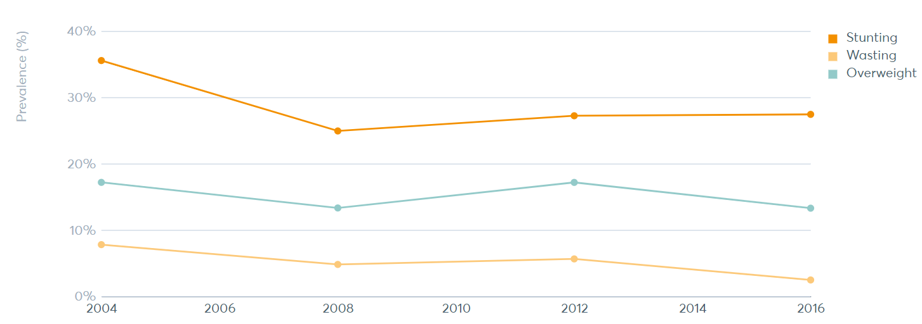
Problem background and description
Data for South Africa
(Source: Global Nutrition Report, 2016)

Slide 7
Problem background and description
Previous Interventions
Avoiding the frequent consumption of juice or other sugar-containing drinks.
Promotion of a balanced or appropriate diet.
1
2
Good nutritional quality food provided in local markets at an affordable price.
Rapidly clearing food from the child’s oral cavity.
5
3
4
(Source: The South African Journal of Clinical Nutrition, 2013)

Slide 8
Scope
This research focuses on an investigation of the factors that influence the proportion of South African children less than 5 years of age with malnutrition.

Slide 9

Objectives
Find the factors that are most influential in impacting malnutrition in South African children under 5 years of age.
Produce a methodology to enable the eResearch team to repeat the data preparation and analysis on other age groups.
Out of Scope
Determine the impact that these factors have on the status of malnutrition in South African children under the age of 5 years
Objectives

Slide 10
Achievements
Managed to apply machine/statistical learning techniques to complex survey data.
Managed to train an XGBoost model that is more accurate compared to a normal Logistic regression model.
We have set up a methodology that can be used for other age groups.
The XGBoost model managed to identify more influential features that have not yet been identified by other studies such as source of drinking water, sex of household head, giving child plain water and number of household members.

Slide 11
Methodology
Data Collection/
Understanding
Data Preparation/
Cleansing
Model Development/
Evaluation
Final Model Selection
Data Analysis
1
2
3
4
5
Data collected from the client and understood
Extraction of data relating to children under 5years
Handling of missing information
Feature engineering
Bivariate/
Multi-variate
analysis
Data
Visualization
Multicollinearity
check
Training of Machine Learning models for survey data
Models performance evaluated and compared
Important features identified by the best performing model
The dataset was obtained from a 2016 Child Nutrition survey from the Demographic & Health Surveys website

Slide 12
Data Pre-processing

Slide 13
Features relevant
for analysis
Feature | Description |  | Description |  |  |  | Description
v005 | individual sample weight (6 decimals) | v149 | educational attainment | v025 | type of place of residence | v730 | husband/partner's age
hw1 | child's age in months | v701 | husband/partner's education level | v501 | current marital status | b19 | current age of child in months
hw70 | height/age standard deviation (new who) | v702 | husband/partner's highest year of education | v704 | husband/partner's occupation | v151 | sex of household head
hw71 | weight/age standard deviation (new who) | v715 | husband/partner's total number of years of education | m18 | size of child at birth (birth weight) | b4 | sex of child
hw72 | weight/height standard deviation (new who) | v729 | husband/partner's educational attainment | hw2 | child's weight in kilograms (1 decimal) | b8 | current age of child
v012 | respondent's current age | v113 | source of drinking water | hw3 | child's height in centimetres | v106 | highest educational level
v152 | age of household head | v103 | childhood place of residence | v190 | wealth index combined | v107 | highest year of education
v212 | age of respondent at 1st birth | v024 | region | v131 | ethnicity | v133 | education in single years
Total Features = 41

Slide 14
Features relevant
for analysis
Feature | Description |  | Description |  | Description
v705 | v705 husband/partner's occupation (grouped) | v717 | respondent's occupation (grouped) | v136 | number of household members (listed)
v716 | respondent's occupation | v409 | gave child plain water
v190a | wealth index for urban/rural | v201 | total children ever born
v191 | wealth index factor score combined (5 decimals) | v153 | household has: telephone (land-line)
Total Features = 41

Slide 15



Data Extraction
Sampling weight variable created as follows:
Sample weight $=\frac{V005}{1000000}$ , V005 = individual sample weight. NB: (guided by literature – DHS Guidelines)
Exclude height recorded with special codes 9995 and 9996.
Children less than 5 years of age
14144 rows,
1040 columns
1116 rows,
41 columns

Slide 16
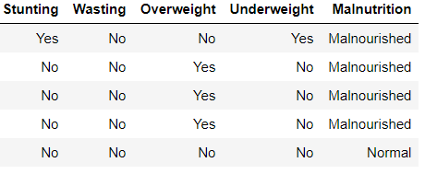
Feature Engineering
Stunted - if height-for-age (HW70) Z-score is below -2 standard deviation (SD)
Wasted - if weight-for-height (HW72) Z-score is below -2 standard deviation (SD)
Overweight – if weight-for-height (HW72) Z-score is above 2 standard deviation and below 9990
Underweight– if weight-for-age (HW71) Z-score is below -2 standard deviation (SD)
HW70 < -200
HW72 < -200
HW72 > 200 & HW72 < 9990
HW71 < -200
NB: At least one of the indicators should be “Yes” for a child to be malnourished. Overweight and Underweight cannot both have “Yes” at the same time.

Slide 17
Analysis Results

Slide 18
Data Visualization (sampling weight incorporated)

Slide 19
Data Visualization(continues…) (sampling weight incorporated)

Slide 20
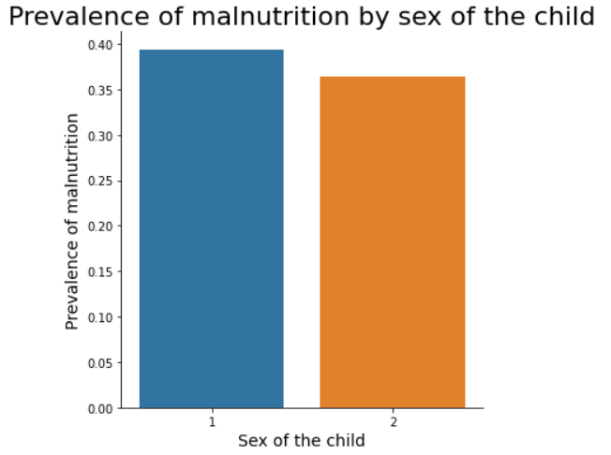
Data Analysis (sampling weight incorporated)
Sex of the child (B4)
1 - Male
2 - Female

Slide 21
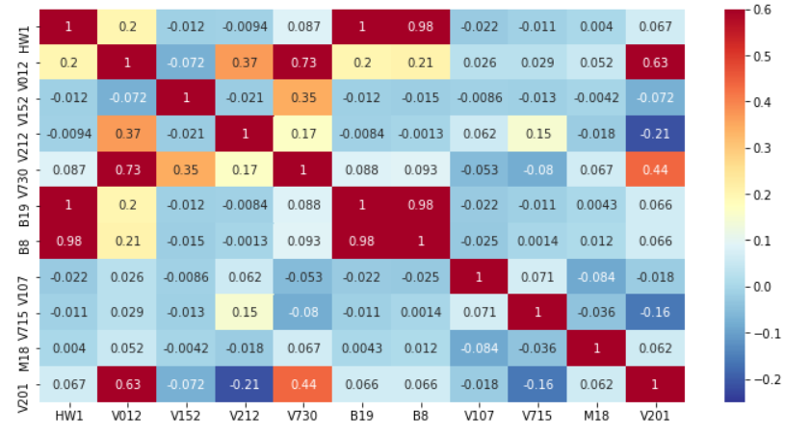
Data Analysis(continues…) (sampling weight incorporated)
Correlation heatmap for continuous/numeric variables – before removing highly correlated features

Slide 22
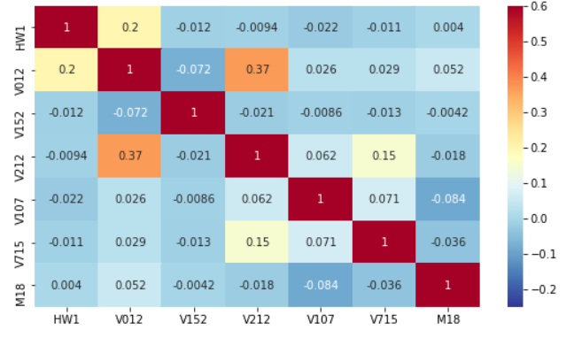
Data Analysis(continues…) (sampling weight incorporated)
Correlation heatmap for continuous/numeric variables – after removing highly correlated features

Slide 23
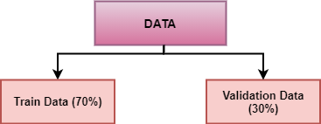
Model development (sampling weight incorporated)
About 40% (446 of 1116) missing information in the variables after extracting only the data relating to children less than 5 years.
These variables were dropped as they had a lot of missing information.
Data Split
Models fitted
XGB (eXtreme Gradient Boosting) - Boosting is an ensemble technique where new models are added to correct the errors made by existing models. Models are added sequentially until no further improvements can be made. Gradient boosting is an approach where new models are created that predict the residuals or errors of prior models and then added together to make the final prediction. It is called gradient boosting because it uses a gradient descent algorithm to minimize the loss when adding new models.
Random Forest - is a tree-based machine learning algorithm that leverages the power of multiple decision trees for making decisions or predictions. As the name suggests, it is a “forest” of trees! It combines the output of multiple (randomly created) decision trees to generate the final output.
Logistic Regression

Slide 24
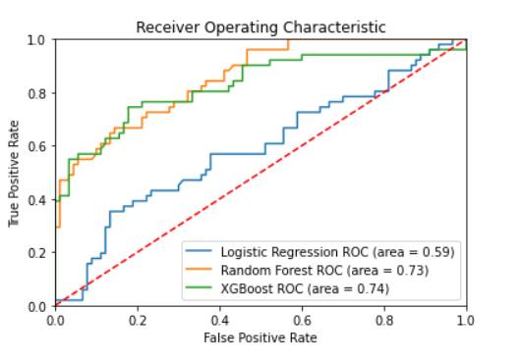
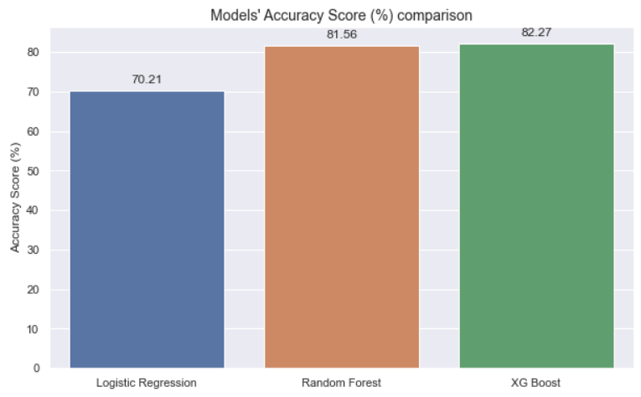
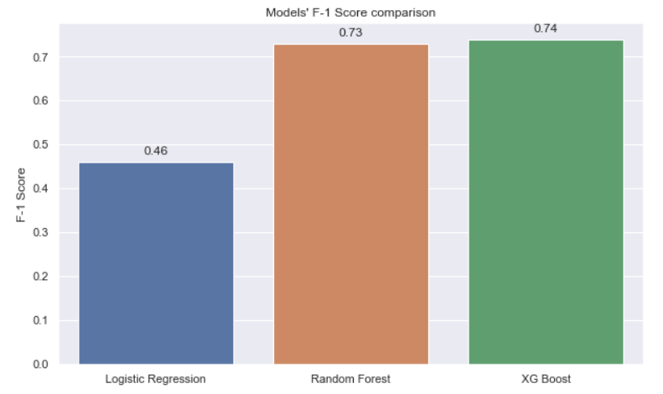
Model Evaluation (sampling weight incorporated)
Models’ evaluation metrics comparison
Accuracy Score
Logistic Reg (AUC = 0.70)
Random Forest (AUC = 0.80)
XGBoost (AUC = 0.89)
XG Boost | Misclassification rate | AUC Score | F-1 Score
Training dataset | 0.1593 | 0.91 | 0.76
Validation dataset | 0.1773 | 0.89 | 0.74
Random Forest | Misclassification rate | AUC Score | F-1 Score
Training dataset | 0.1733 | 0.83 | 0.75
Validation dataset | 0.1844 | 0.80 | 0.73
Logistic Reg. | Misclassification rate | AUC Score | F1-Score
Training dataset | 0.2758 | 0.73 | 0.50
Validation dataset | 0.2979 | 0.70 | 0.46

Slide 25
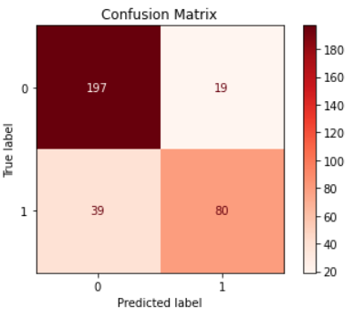
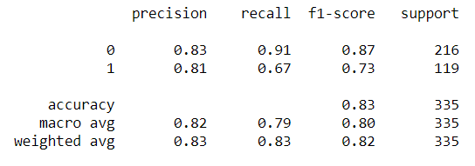
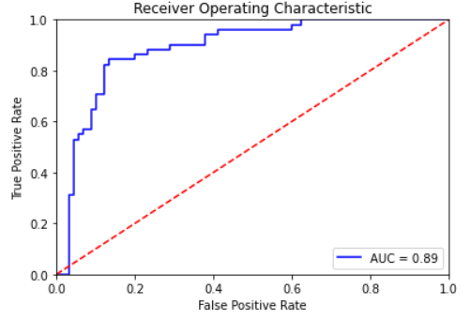
Model Selected – XG Boost
Confusion Matrix
Classification Report (Maximize Precision)

Slide 26
Important Features
Important features identified by the selected model – XG Boost
The importance is calculated based on the decrease in node impurity weighted by the probability of reaching that node.
The node probability can be calculated by the number of samples that reach the node, divided by the total number of samples. The higher the value the more important the feature.

Slide 27
Conclusion
The prevalence of malnutrition tends to be higher among children coming from households where tank water is the source of drinking water.
Prevalence of malnutrition generally decreases as the family or household gets richer. This might be due to a family being able to afford quality food and a proper diet.
A significant proportion of children with malnutrition can be observed from children living in rural and farm areas.
A higher proportion of malnourished children who were smaller than normal in size at birth (less than 2.5kg) can be observed.

Slide 28
Future Research
Determine the impact that the factors identified in this research have on the status of malnutrition in South African children under the age of 5 years.
The methodology can be used on other age groups.

Slide 29
Deliverables
Original (raw) and cleaned data set with relevant features
Report providing information on influential factors on prevalence of malnutrition
Reproducible methodology that can be used for children between 5 and 12 years
Python notebook with the full code used to carry the analysis

Slide 30
Questions?

